Slide 1
Quarterly Update on the National Inventory Collaborative
September 26, 2019

Slide 2
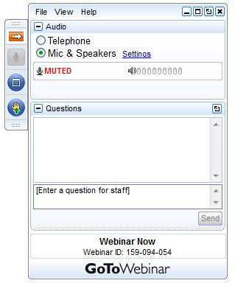
Webinar Ground Rules: Questions?
Each workgroup will give a ~5 minute update describing their work over the last quarter and their plans for the coming months.
All call participants will remain on mute during the webinar.
Type your questions into the question box on the webinar client.
We will try to answer questions at the end of the webinar.
We will create a Q&A document following the webinar and post with the meeting notes on the Collaborative Wiki: http://views.cira.colostate.edu/wiki/wiki/9169

Slide 3
Overview of the Platform Collaborative
A new multi-purpose emissions modeling platform (EMP) based on the 2014 National Emissions Inventory version 2 (2014NEIv2) is needed
  State Implementation Plans, federal analyses
  For the first time, EPA, states, and MJOs are engaging in collaborative EMP development
  The 2016 base year was selected via a collaborative process
Future years selected due to regulatory relevance
  2023 is relevant for Ozone NAAQS moderate areas
    2020 is being created by some states/regions for 2008 O3 NAAQS attainment demonstration modeling
  2028 for regional haze

Slide 4
2016 EMP Schedule
Several versions of 2016 platform will be developed
  Alpha: preliminary version based on 2014NEIv2 for some and 2016 for other key sectors (released Spring, 2018)
    For initial testing of 2016 model runs
    Compatible versions of 2014 and 2015 were also released
    https://www.epa.gov/air-emissions-modeling/2014-2016-version-7-air-emissions-modeling-platforms
  Beta: improved and/or new version of actual 2016 emissions for most sectors (March 2019) and preliminary projected emissions for 2023 and 2028 (to workgroups in April 2019)
  V1.0: fully updated 2016 emissions and complete projected emissions for 2023 and 2028 (October 2019)

Slide 5
Organizational Structure
Coordination co-leads: Zac Adelman (LADCO) and Alison Eyth (EPA OAQPS)
  Developed process and communication structures, facilitate discussions, help resolve issues, documentation requirements, coordinate distribution of data to stakeholders
Coordination committee: regional, state, EPA leaders
  Define processes, resolve issues, co-lead workgroups
  Includes overall and WG co-leads plus MJO directors
Sector-specific Workgroups: one regional/state staff and one EPA staff (where possible)
  Focus on preparing emissions estimates for 2016 and future years, plus improve how the emissions sectors are modeled
  Include participants from EPA/states/locals/regions

Slide 6
Objectives of Today’s Webinar
Recap available information for beta
Present the plans for the version 1 release, including data updates and schedule

Slide 7
2016 Beta Release Recap
Emissions Release Date: March 13, 2019
  http://views.cira.colostate.edu/wiki/wiki/10197
  AQM-ready data and all SMOKE inputs are available from the Intermountain West Data Warehouse (IWDW) Request Data Page
2016 beta base year release contents
  2016 SMOKE inputs and scripts
  SMOKE outputs by sector
  CMAQ and CAMx-ready emissions at 36km and 12km
  Documentation as specification sheets, data summaries
  Interactive maps at IWDW, static charts and maps at LADCO
Met data, IC/BCs, and AQM outputs were transferred to IWDW after the emissions release
To-date, 88 requests for 2016 beta platform data have been fielded by the IWDW

Slide 8
Beta Release Contents on IWDW
Type | Included? | Grid(s) | Models
2016 SMOKE inputs | Initial | N/A | N/A
2016 SMOKE scripts/ tools | Initial | 12km, 36km | CMAQ, CAMx
2016 SMOKE outputs by sector (aka premerged) | Initial | 12km, 36km | CMAQ*
2016 AQM-ready emissions | Initial | 12km, 36km | CMAQ, CAMx
Emissions plots, summaries | Initial | 12km, 36km | N/A
Documentation (spec sheets) | Initial | N/A | N/A
Met data for AQM | Later | 12km, 36km | CMAQ, CAMx
IC/BCs | Later | 12km, 36km | CMAQ, CAMx
AQM Outputs | Later | 12km, 36km | CMAQ, CAMx
Site Compare Files | Later | N/A | CMAQ, CAMx
Future year inventories | Workgroups
* CMAQ format emissions are produced for each sector;
CAMx format emissions are created after merging CMAQ emissions

Slide 9
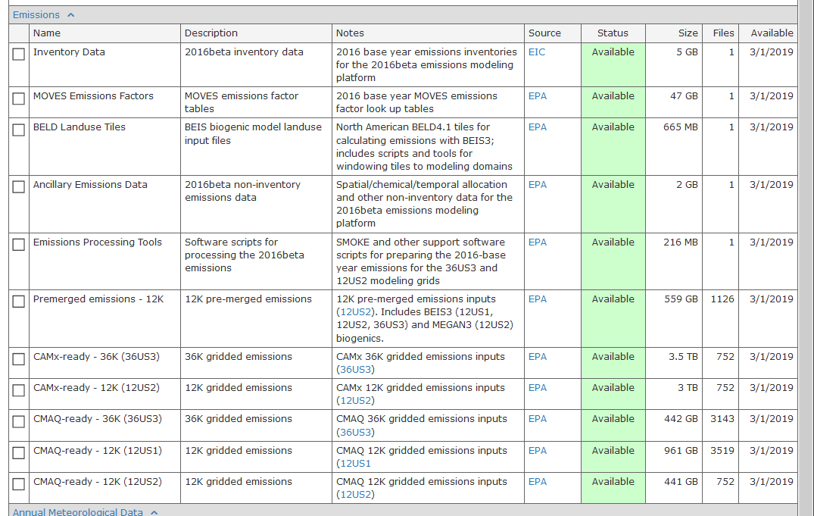
Downloading from IWDW
Once you log in with your account and choose the Collaborative
2016 beta platform, select the components you want to download

Slide 10
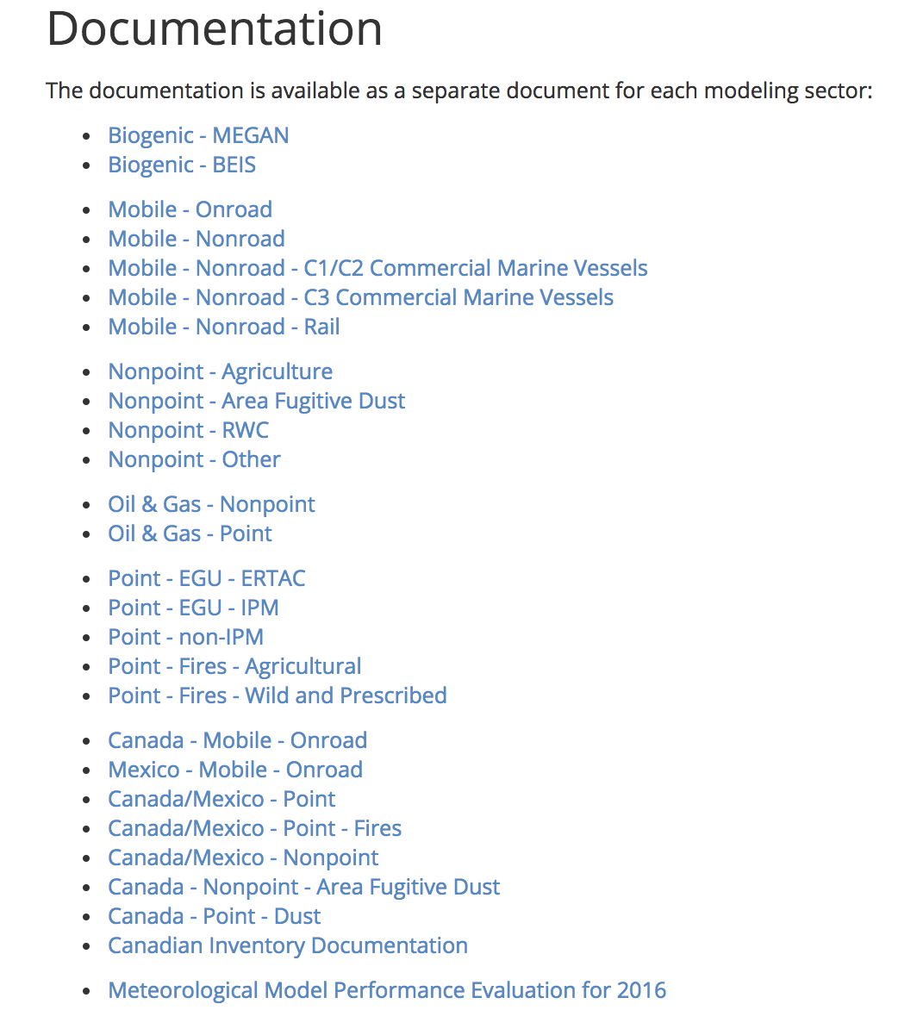
2016 beta Release Documentation
Specification Sheets by sector on beta page of Collaborative Wiki (not as a single TSD)
27 documents in a standardized format
Describe the sector, the SCCs/sources included in the sector, data sources, processing methods
Graphical and tabular summaries of the data (IWDW, LADCO)

Slide 11
2016 Alpha/Beta Known Use Cases
Alpha:
  EPA: Hemispheric modeling to develop 2016 boundary conditions, risk and exposure assessments, testing CMAQ 5.3
Beta:
  EPA: regional haze analyses, modeling of field study areas, CMAQ evaluation
    Regional haze report released last week: https://www.epa.gov/scram/air-modeling-reports-and-journal-articles
  OTC state modeling (NY)
  SIPs (NC, Clark County, MD)
  Attainment demonstration (Denver)
  Regional haze (Texas, HAQAST, EPA)
  AQ Forecasting system (NOAA ARL)
  EPRI analyses of AQM responsiveness (GA Tech),
  EDF modeling (UNC)
  U.S. Fish and Wildlife Service
  Other Analyses (CT, Louisville KY, NC State University, Sonoma Tech, U. Colo Boulder, U.C. Davis, Utah State University, TVA, Univ Connecticut, Colorado State Univ., Maricopa Association of Govermnents, U. Wisconsin Madison, U. MD College Park)
V1:
  Expect uses by MJOs, states, EPA OAQPS, EPA OTAQ, EPA ORD, other groups, researchers
  Post-call survey to request v1 use cases

Slide 12
Status of the 2016v1 platform
Base year 2016 emissions inventories for all sectors have been created and processed through SMOKE at 12km [aka “premerged emissions”]
  36km processing happening this week
2023 and 2028 emission inventories have been created for most sectors
  Still working on other nonpoint emissions (nonpt) and non-EGU point emissions (ptnonipm)
  So far, SMOKE has only been run for onroad [needed to get emissions totals]
Emissions have not yet been merged together to create full AQM-ready inputs
2016v1 spec. sheet documents have been started
  No integrated TSD is planned at this time [similar to beta]
2020 MOVES runs completed for onroad, nonroad

Slide 13
Data to Include in 2016v1 Release Early October
Type | Included? | Grid(s) | Models
2016 SMOKE inputs | Initial | N/A | N/A
2016 SMOKE scripts/ tools | Initial | 12km, 36km | CMAQ, CAMx
2016 SMOKE outputs by sector | Initial* | 12km, [36km probably] | CMAQ
2016 AQM-ready emissions | NO
Emissions plots, summaries | Some | 12km, 36km | N/A
Future year SMOKE inputs | Initial | N/A | N/A
Future year SMOKE scripts | NO**
Future year SMOKE outputs | NO**
Future year AQM-ready emissions | NO
Future year AQM Outputs | NO
* Transfer to IWDW will take some time; Documentation will be in draft form
**Future year scripts and SMOKE outputs can follow later in October

Slide 14
Specific items not ready next week
May not be ready:
  Alaska and Hawaii onroad and commercial marine vessel emissions
  3D fires for use with CAMx
  ERTAC EGU inputs and integration instructions
Will not be ready:
  Integrated form of WRAP oil and gas inventories and ancillary data
  Future year SMOKE scripts and outputs
  AQM-ready emissions will not be provided in October as this requires configuration assumptions to be made
  Final specification sheets documentation (first will have draft)

Slide 15
Collaborative Workgroup Reports
EGUs
Non-EGU Point
Nonpoint
Onroad
Nonroad
Commercial Marine Vessels (CMV)
Rail
Oil and gas sources (point and nonpoint)
Biogenics
Fires
Modeling
Wrap up
Wiki has more information and notes from each workgroup
  http://views.cira.colostate.edu/wiki/wiki/9169

Slide 16
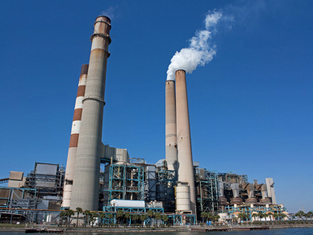
Electricity Generating Units (EGU) Workgroup
Co-leads: Julie McDill (MARAMA), Serpil Kayin (EPA CAMD), Alison Eyth (EPA OAQPS)
Schedule: Calls 4th Thursday at 2:00pm ET
Wiki: http://views.cira.colostate.edu/wiki/wiki/9174

Slide 17
EGU Workgroup: 2016v1
Base Year Approach
  Only a few updates planned from beta to v1
Comments on beta
  Data on NJ and Alaska EGUs
  Updates to temporal profiles for some EGUs without CEMS in MARAMA states
  Various comments from VA
Differences from beta
  Base Year (2016): EGU emissions and temporal profiles will be updated to address as many comments as possible
  A few sources moved from the non-EGU file to the EGU file
  Projection Years: Updated versions of data for both ERTAC and IPM will be available
Milestones
  Expected release date: September 2019

Slide 18
EGU Workgroup: ERTAC-EGU
Runs with new inputs of CONUS v16.0 complete
  Current: v16.0
    Base year 2016; Future years 2020, 2023, 2028
    Other years if needed
  Minor updates to v16.0 for 2016 v1: new CAMD data, hourly calculation methodology for base year
  CSAPR-compliant, meets state assurance levels
ERTAC-EGU SMOKE processing package
  NYDEC & LADCO developing run scripts (w/ instructions & documentation) for processing ERTAC- EGU and associated small EGU and non-EGU files
  Plan to complete for v1 release
  Will be posted with the rest of the v1 platform

Slide 19
EGU Workgroup: ERTAC-EGU
ERTAC-EGU Next steps – Developing v16.1
  State outreach – comments by Sept. 27
  Updated growth factors (all)
  Updated shutdowns, controls, retirements
Ongoing review – EPA & ERTAC-EGU
  Small group of sources where EPA and ERTAC-EGU characterizations differ (EGU/small EGU/nonEGU)
    ID crosswalk issues
    Non-fossil fuels (e.g., biomass, tire-derived)
    EGUs at industrial facilities

Slide 20
EGU Workgroup: IPM
EPA has updated its Power Sector Modeling Website with new IPM projections (IPM v6 May 2019 Reference Case)
  Including NEEDS, incremental documentation and unit level results for 2023 and 2030
  This version is included in 2016 v1
  See https://www.epa.gov/airmarkets/clean-air-markets-power-sector-modeling
Updates in new version include
  Additional closures and committed units
  Adjustments to SO2 EFs for coal units
  Updated methodology for PM post-processing

Slide 21
EGU Workgroup: IPM
EPA will continue to issue quarterly NEEDS updates
  Next one is planned for the end of September 2019
EPA periodically reviews and updates State Rules and Regulations effecting power plants (as well as NSR, State and Citizen Settlements, and BART Regulations) for IPM model implementation
  CAMD initiated a review by contacting EPA Regional Air Program Managers and EGU WG
  We expect reviews and feedback by October 18
  Any new rules and discrepancies will be reflected in the next versions of modeling

Slide 22
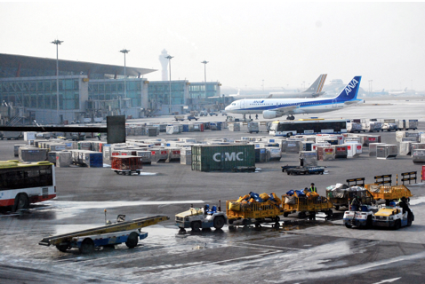
Non-EGU Point Workgroup
Co-leads: Tammy Manning (NC DEQ), Caroline Farkas (EPA)
Schedule: Calls on 3rd Tuesday at 2:00pm Eastern
Wiki: http://views.cira.colostate.edu/wiki/wiki/9177

Slide 23
Non-EGU Point Workgroup:
Base Year Updates
Differences from beta for non-EGU point
  DC replacement inventory
  Closures (VA, MA, NY), closures revoked in NC
  GA anomalies
  NJ applicable controls
  MA State rules and Consent Decrees
  Ethanol and biorefinery plants updated
Airports
  Finalized and moved to a separate modeling sector
  2017NEI aircraft emissions estimated using the FAA’s Aviation Environmental Design Tool (AEDT)
    Major method changes between AEDT model (used for 2017 NEI airport emissions) and previously used model
  Airport emissions back-casted from 2017 to 2016 using FAA historical data

Slide 24
Non-EGU Point Workgroup: Future Year Updates
Differences from beta for non-EGU point
  Nearly finalized
  Industrial sources projected by SCC and SCC-NAICS using AEO 2019 data
  MARAMA growth & control factors
    Including MANEVU sulfur rules, NSPS (NG Turbines, RICE, Process heaters), State rules & consent decrees
  Growth and control factor edits from beta submitted by states
    NY, DC, MA, NJ, NC, NM, VA, WI
  New impacted units for AZ Regional Haze
  Consent Decrees reevaluated (removed those with compliance dates that have passed, added a few new units)
  Ethanol and biorefinery plants projected
Airports
  Finalized
  Projection factors created using airport-specific numbers from the FAA’s Terminal Area Forecast (TAF), where available – standard approach, new base emissions (see above)

Slide 25
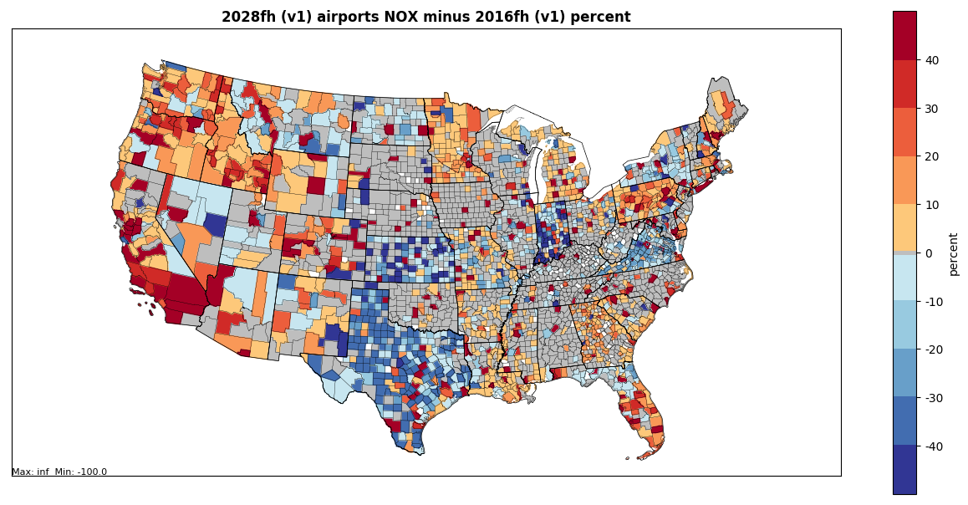
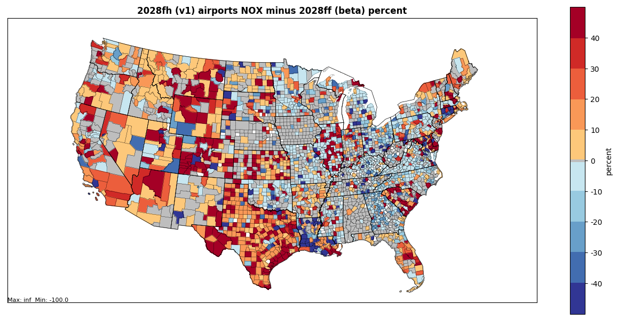
Airport difference maps

Slide 26
NonPoint Workgroup
Co-leads: Caroline Farkas (EPA), Jennifer Snyder (EPA)
Schedule: Calls on 4th Monday at 2:00pm Eastern
Wiki: http://views.cira.colostate.edu/wiki/wiki/9178

Slide 27
NonPoint Workgroup: Base Year Updates
Differences from beta
  Afdust: Finalized; VMT for road dust updated to match onroad mobile VMT for 2016v1
  Ag NH3:
    Finalized
    New fertilizer application emissions
    Livestock emissions 2017NEI backcasted to 2016 - corrects underprediction in dairy cows and poultry
  Nonpoint-other: Nearly Finalized
    Population-based activity data projected to 2016 using US Census data (e.g., consumer products, solvents, commercial cooking)
    NC BoilerMACT controls and growth information

Slide 28
NonPoint Workgroup: Future Year Updates
Differences from beta
  Afdust: finalized; State-submitted projection factors (MARAMA, NJ, NC)
  Ag: finalized; livestock projected using Feb 2019 USDA national projections
  RWC: finalized; VT & NC submitted new factors
  Nonpoint-Other
    Nearly finalized
    Industrial sources updated to use Annual Energy Outlook (AEO) 2019
    Control factors previously reevaluated (e.g., RICE NSPS, Boiler MACT, Fuel Sulfur rules, PA RACT)
    Submitted edits included (MARAMA, NJ, NY, NC)
    Cellulosic emissions included

Slide 29
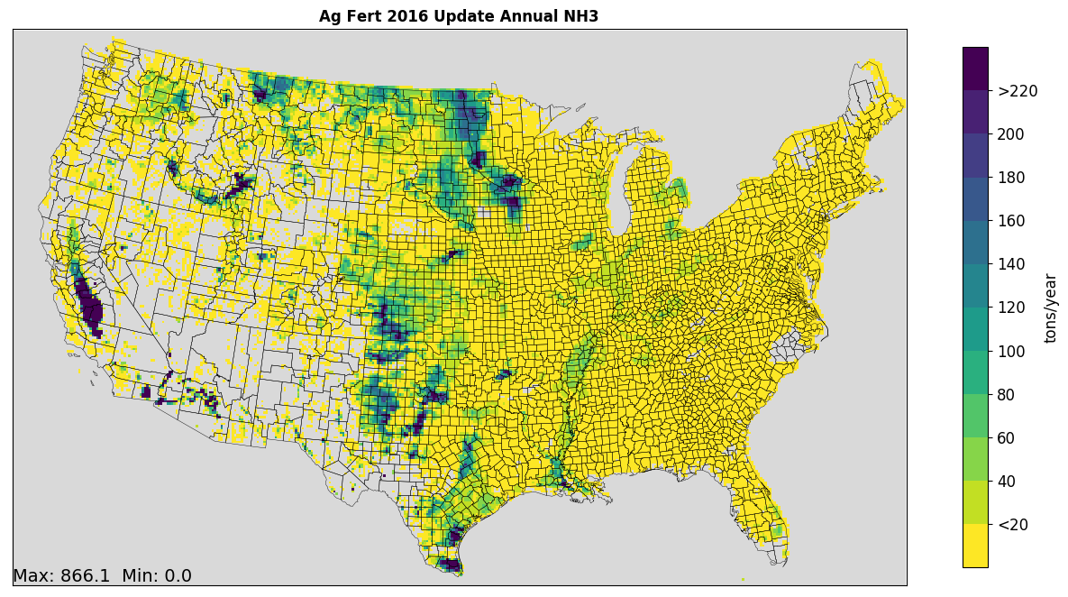
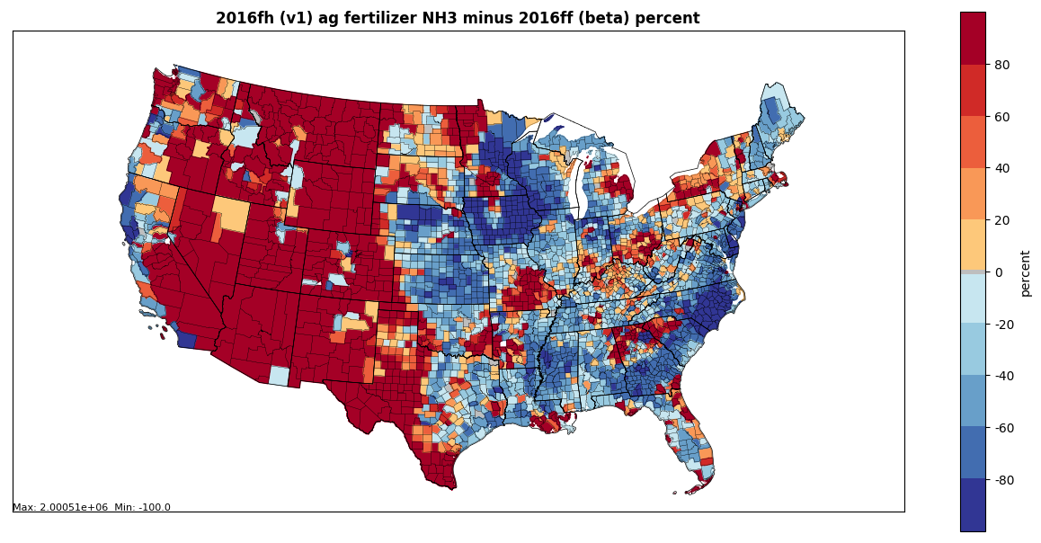
Ag Fertilizer
Ag Fert 2016fh (v1) NH3
New 2016 fertilizer emissions provided by EPA ORD
No growth assumed for projection years
Most larger increases
in areas with low
emissions

Slide 30
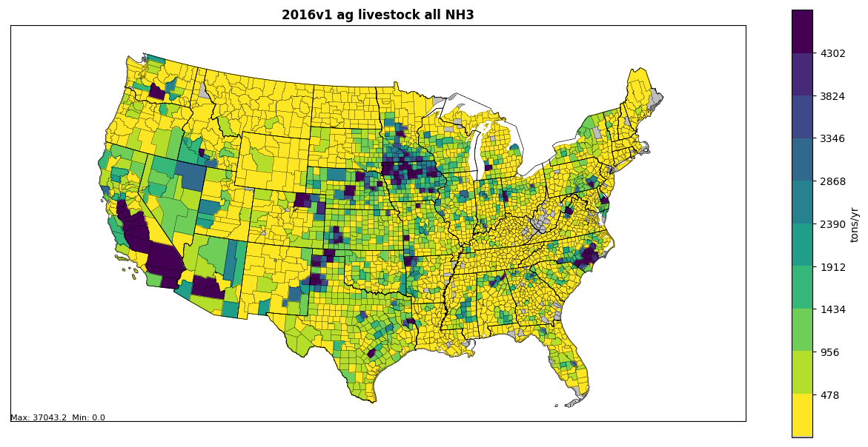
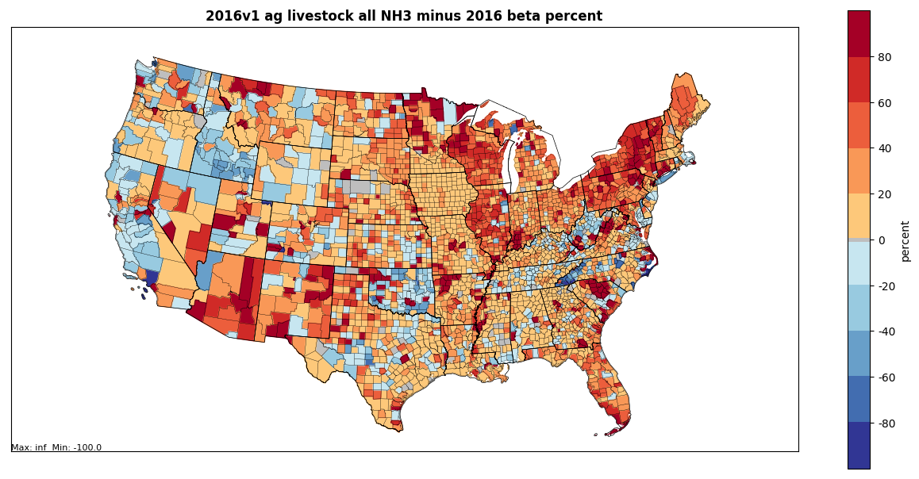
Ag Livestock
2016v1 emissions based on 2017 NEI
Poultry (layers) and Dairy cattle are largest increases

Slide 31
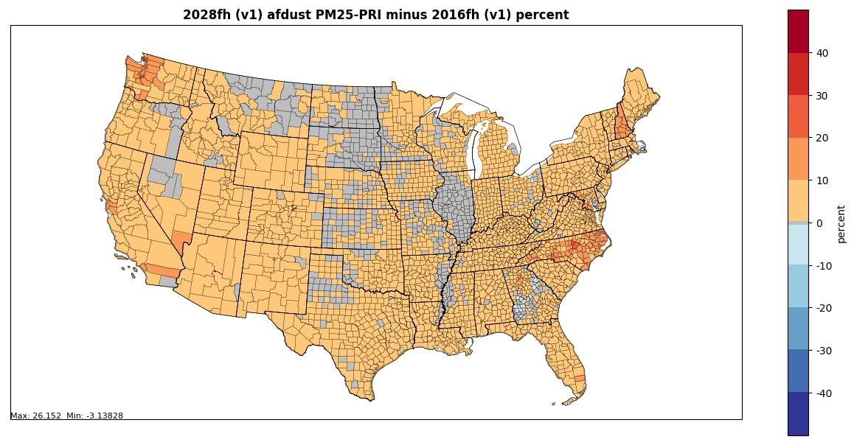
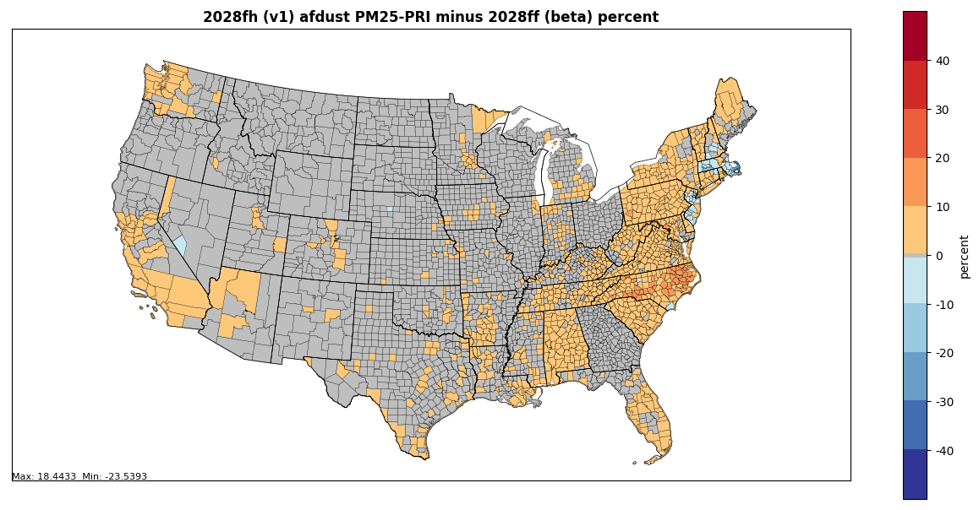
Afdust difference maps
Largest increases in projected emissions are from paved roads fugitive dust and crop tilling
Changes in MARAMA states are from updated growth packets for v1

Slide 32
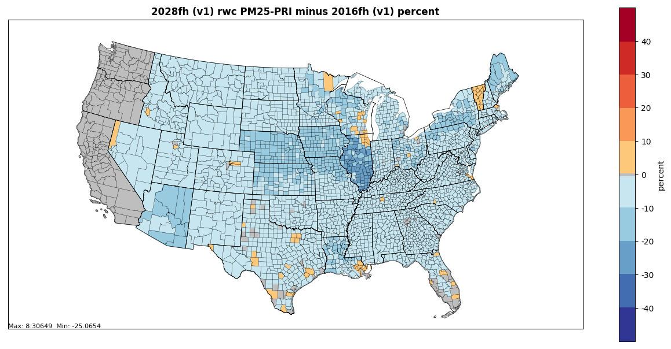
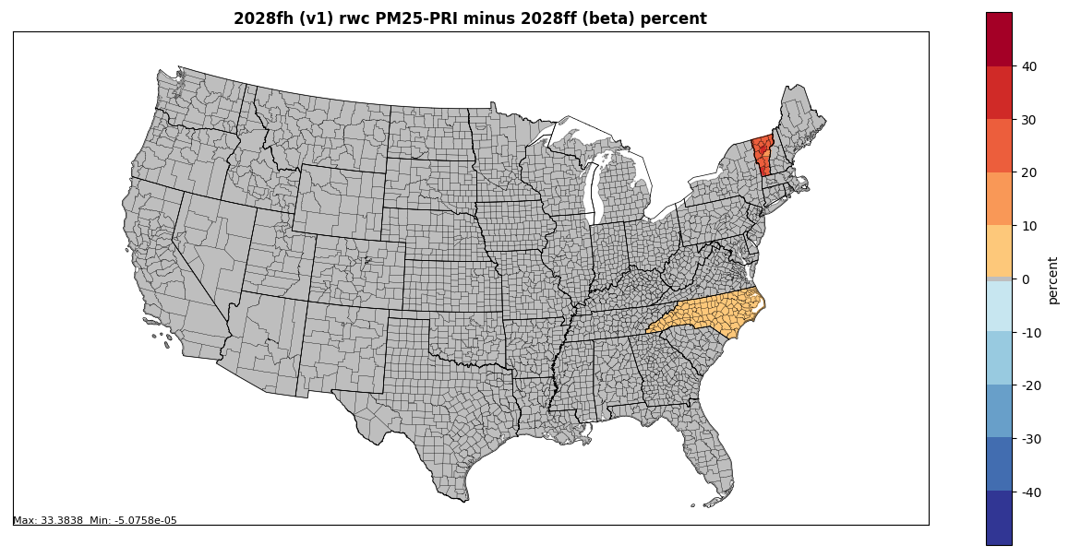
RWC difference maps
VT and NC submitted edits for v1
CA, OR, WA have no growth for future year scenarios
Largest decreases in projections are from indoor wood non-EPA certified furnaces

Slide 33

Onroad Mobile Workgroup
Co-leads: Julie McDill and Debbie Wilson (MARAMA), Alison Eyth (EPA OAQPS)
Schedule: Calls 3rd Thursday at 2:00pm ET
Wiki: http://views.cira.colostate.edu/wiki/wiki/9181

Slide 34
Onroad Workgroup: 2016v1
Differences from beta
  Incorporated new state-supplied MOVES input data
  Activity data (VMT and VPOP) were updated for states that provided new data for 2016v1
  Long haul combination truck hoteling hours were reduced based on new information
  Vehicle age distributions were updated to represent 2016 based on CRC A-115 VIN decode project for 2017 NEI
  Representative counties were updated to reflect new data
  MOVES was run with updated inputs to create new emission factors for 2106, 2020, 2023, and 2028
  VMT projection factors updated to use AEO 2019
  SMOKE-MOVES was run using the new emission factors with updated activity to create emissions
    SMOKE-MOVES now uses average speed distributions; and gridded hourly meteorological data for NOx humidity adjustments
  Future year age distributions account for recession

Slide 35
New Onroad Input Data for 2016v1
NOTE: These are only updates in addition to activity data provided for beta
California: Emissions for 2016, 2023, 2028
Chicago area: 2016 VMT; VPOP; some other MOVES inputs
Colorado: 2014 and 2017 vehicle populations and age distributions
Georgia: 2016 fuel supply and other comments
Maryland: Updates to truck stop data and rep. counties
Massachusetts: 2016 VPOP and VMT
Michigan: new rep. counties
New Jersey: 2016 age distribution and vehicle populations, new rep. counties, 2023 and 2028 age distribution and vehicle populations
North Carolina: updated future year inspection / maintenance (I/M) programs
Pima Association of Governments: VPOP, age distribution, I/M information for 2016
New York: new rep. counties
Wisconsin: n/c to 2016, ‘23, ‘28; 2020 VMT and VPOP, age distributions; I/M inputs
Louisville area: 2016 county total VMT; ’20, ’23, ‘28 VMT; speed distributions and urban/rural road type splits

Slide 36
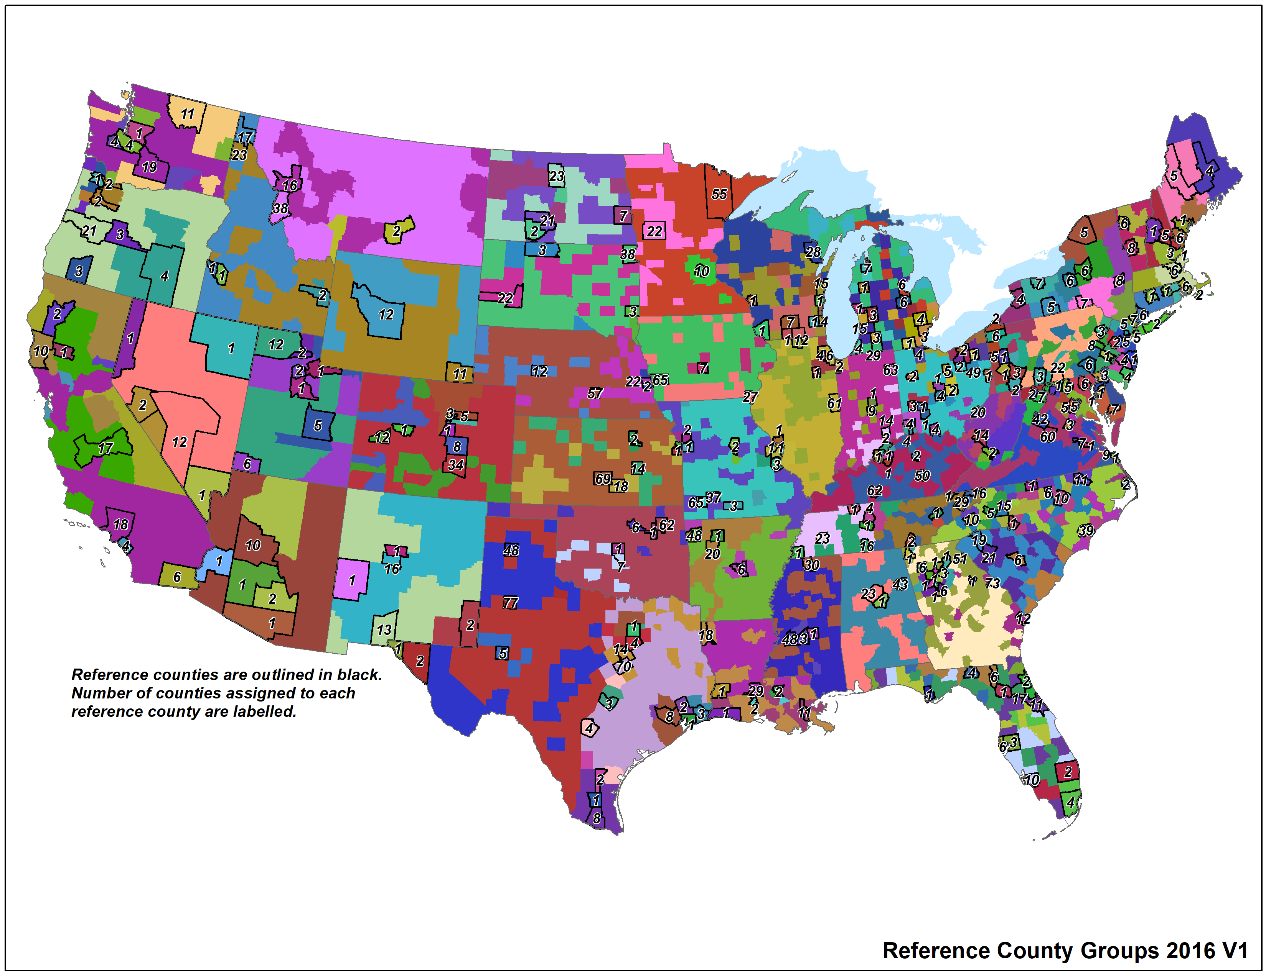
2016v1 Representative Counties
315 representative counties for 2016v1

Slide 37
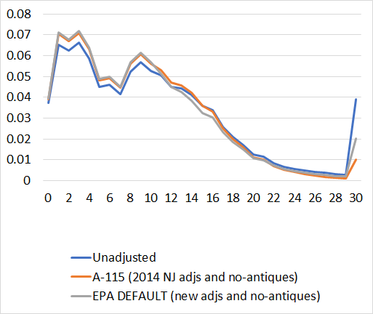
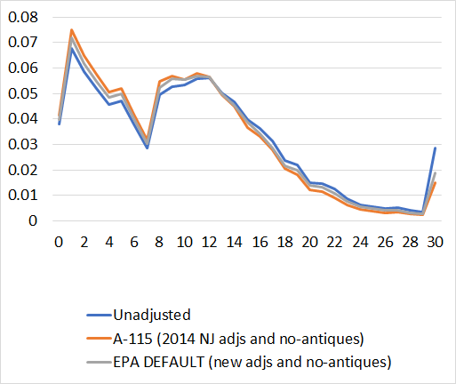
Default 2016 age distributions
Nationwide average
21 – Passenger Car
31 – Passenger Truck
Age (Years Old)
Age (Years Old)
CRC A-115 methods updated with 2017 NEI data

Slide 38
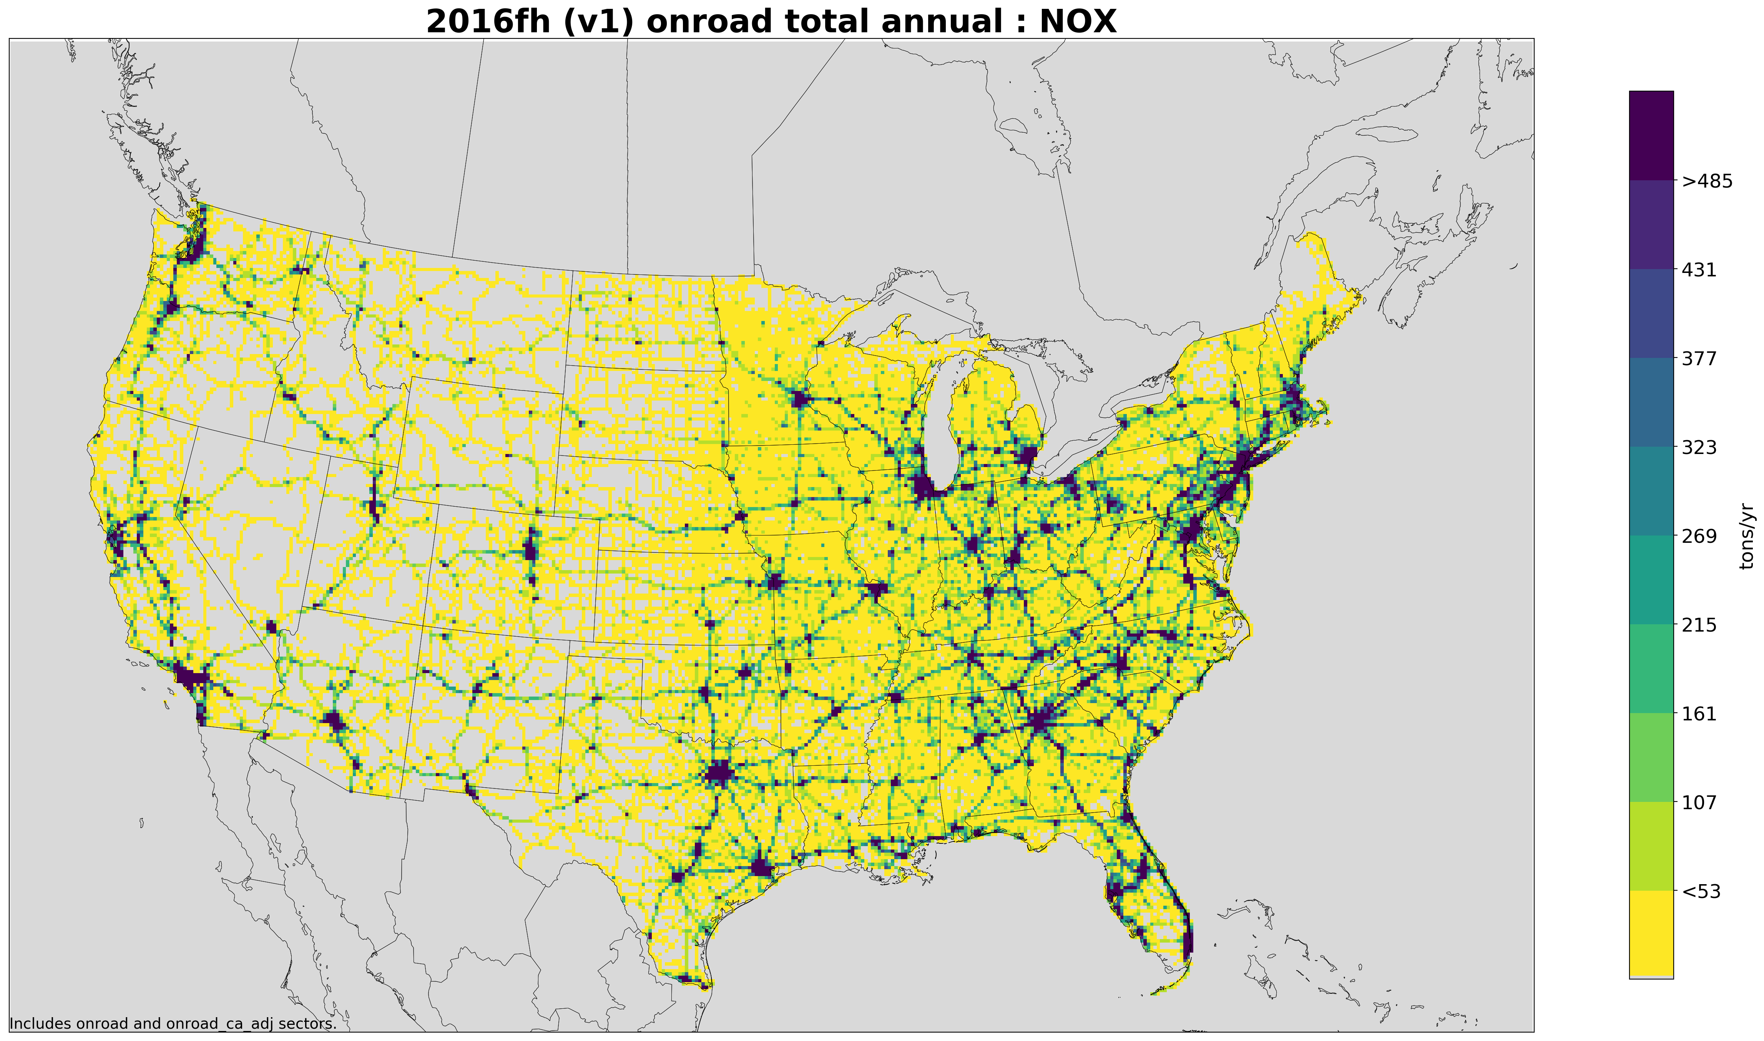
12km Gridded 2016v1 Onroad NOx Emissions

Slide 39
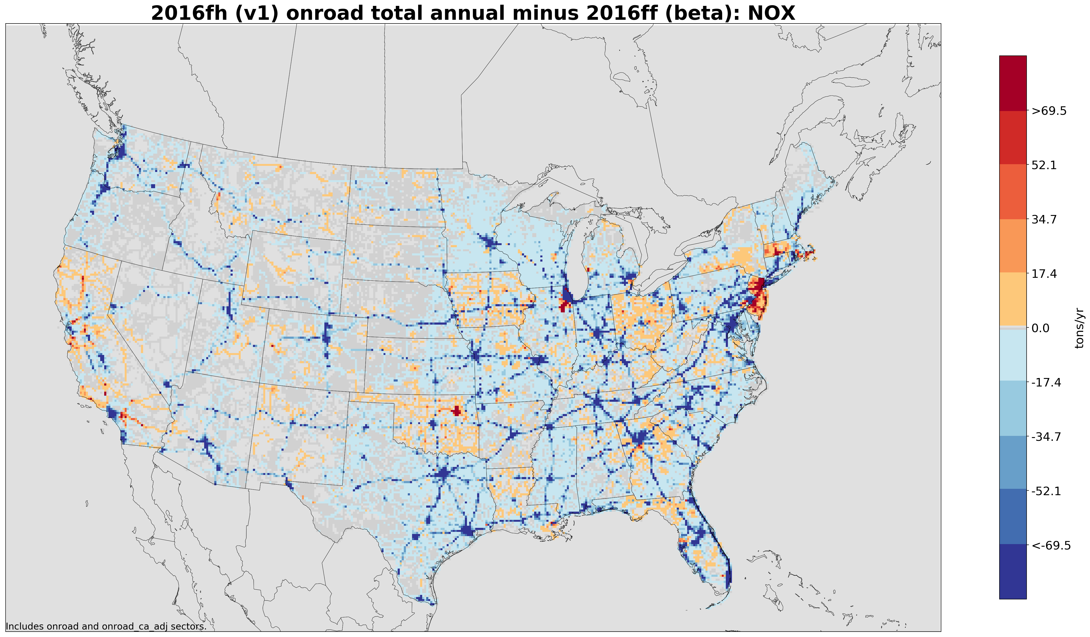
Gridded Onroad NOx v1-beta
Decreases in hoteling along interstates are clear

Slide 40
2016v1 Platform Con. US Onroad Emissions Compared to 2016beta
ff = beta
fh = v1
poll | 2016v1 | 2023v1 | 2028v1 | 2016v1/ 2016beta | 2023v1/ 2023beta | 2028v1/ 2028beta
CO | 19,889,617 | 13,773,993 | 10,308,234 | 0.98 | 0.97 | 0.99
NH3 | 100,318 | 89,285 | 87,913 | 0.99 | 1.02 | 1.05
NOX | 3,630,548 | 1,750,937 | 1,246,019 | 0.89 | 0.90 | 0.92
PM10-PRI | 239,997 | 199,979 | 189,838 | 0.88 | 0.89 | 0.90
PM25-PRI | 117,758 | 72,468 | 58,925 | 0.90 | 0.92 | 0.93
SO2 | 27,559 | 12,484 | 11,703 | 1.00 | 1.01 | 1.01
VOC | 1,852,260 | 1,098,966 | 836,112 | 0.93 | 0.92 | 0.94

Slide 41
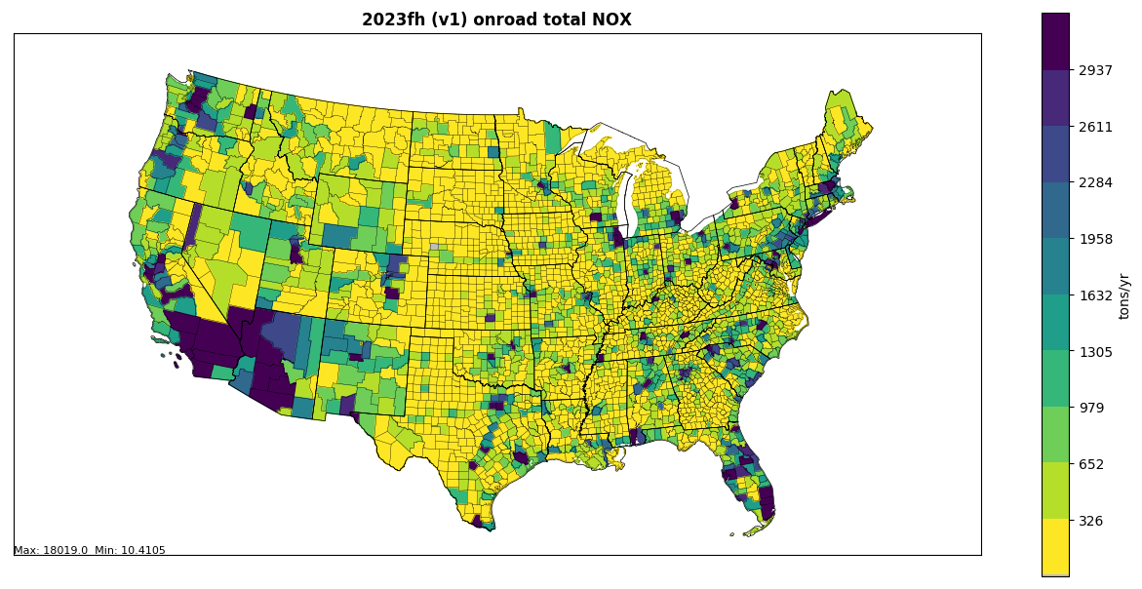

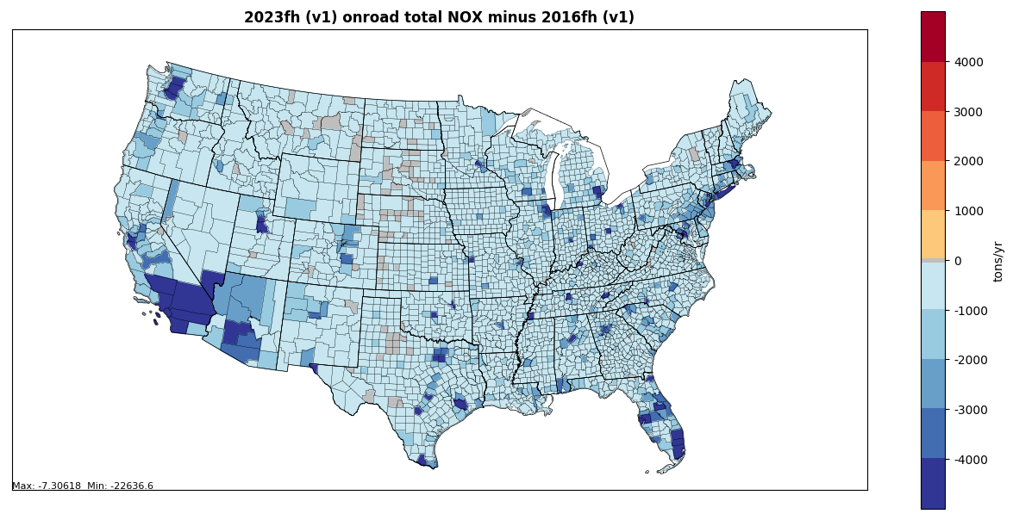

Total Onroad NOx 202x-2016
2023 v1 Onroad total NOx
2028 v1 Onroad total NOx
2023 minus 2016 v1 NOx
2028 minus 2016 v1 NOx

Slide 42
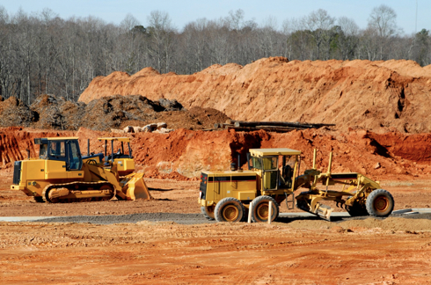
Nonroad Mobile Workgroup
Lead: Sarah Roberts (EPA OTAQ)
Wiki: http://views.cira.colostate.edu/wiki/wiki/9179
Milestones:
  v1 base and future year inventories complete; currently finalizing documentation
  Emissions provided by California and Texas have been incorporated into the v1 nonroad inventories

Slide 43
Nonroad Workgroup: 2016v1
Approach
  Ran MOVES2014b with state-supplied data and updated factors for allocating Agricultural and Construction equipment
MOVES Run Setup
  Reviewed data submitted for 2017 NEI and incorporated into 2016v1 where appropriate, for example:
    Month and spatial allocations of snowmobiles in UT
    Recreational marine allocations in WA
    Updated equipment populations in Maricopa County (AZ), UT, CT
  Updated Agricultural and Construction equipment allocations to the state- and county-level (Work Group update)
  Updated fuel supply and equipment allocations in GA
  Temporal (month) profiles for Agricultural equipment activity in LADCO states

Slide 44
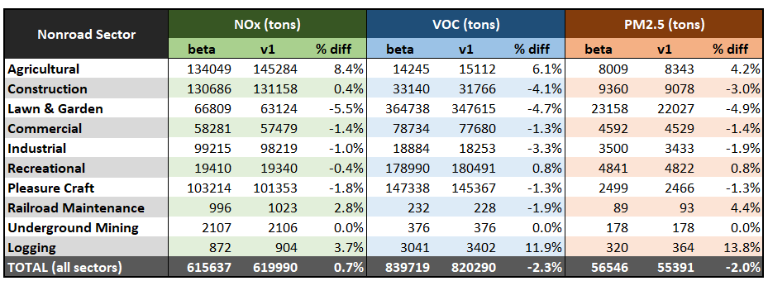
Nonroad Workgroup: 2016v1
For beta, ran MOVES2014b using model defaults (no state-supplied data)
Differences between 2028 beta and v1 inventories are the result of the inclusion of state-supplied data and work group’s updates to the allocation of Construction and Agricultural equipment in v1
2028 Nonroad Emissions by Sector: beta vs. v1
Notes: emissions from Airport Support and Oil Field Equipment are excluded from nonroad inventories.
Above summaries include Puerto Rico and U.S. Virgin Islands.

Slide 45
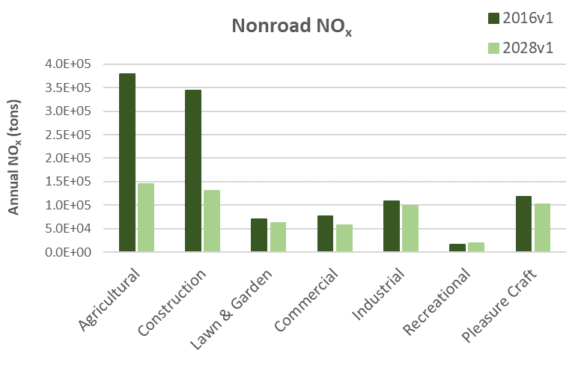
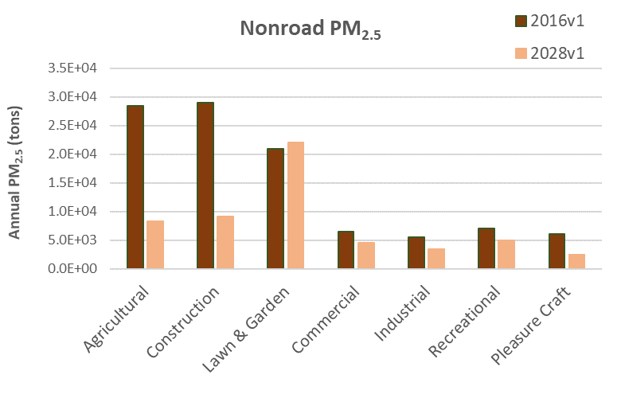
Nonroad Workgroup: 2016v1
Declines in emissions from 2016 to 2028 are the result of equipment turnover → newer, cleaner engines are projected to dominate the market in future years
-61.6%
-61.9%
-9.2%
-13.6%
-10.5%
-25.8%
+21.5%
Nonroad engine regulations driving emissions reductions include:
  Tier 4 standards for nonroad diesel engines (starting in 2008)
  Emission standards for new nonroad spark-ignition engines, equipment, and vessels (starting in 2010)
-68.8%
-70.6%
+5.0%
-30.2%
-37.9%
-30.4%
-59.2%

Slide 46
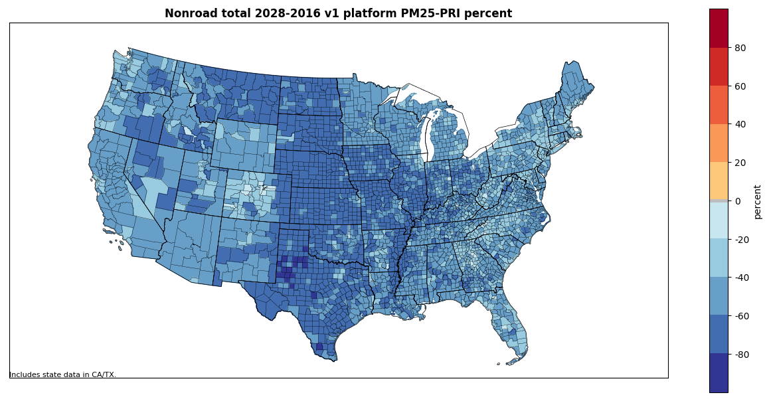
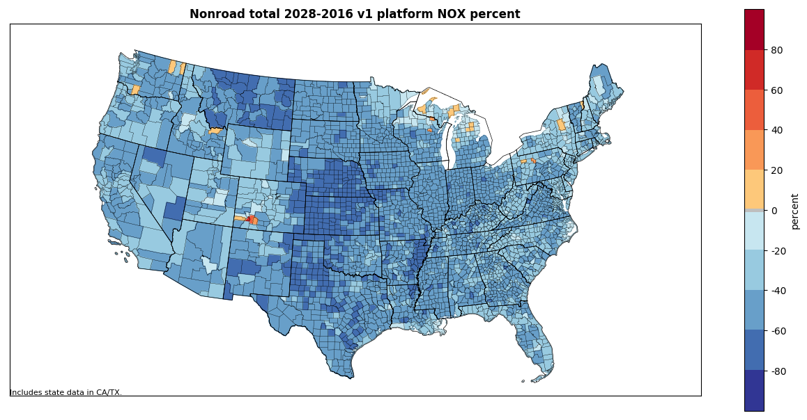
Nonroad Workgroup: 2016v1
National Summary
Pollutant | % difference (2028-2016)
NO_{x} | -44.8%
VOC | -28.9%
PM_{2.5} | -47.1%
PM₁₀ | -46.3%
SO₂ | -27.7%
CO | +2.9%

Slide 47
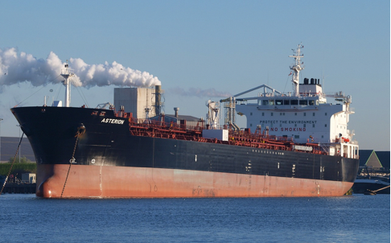
Commercial Marine Vessel (CMV) Workgroup
Lead Mark Janssen (LADCO); update provided by EPA
Schedule: Ad hoc
Wiki: http://views.cira.colostate.edu/wiki/wiki/9176
47

Slide 48
Marine Workgroup: 2016v1 Status
For C3 and C1C2, AIS-based hourly emissions data files for each day were generated for rasterization
Rasterized C3 and C1C2 onto 36-km and 12-km gridded (hourly) data for CONUS
  During this process, adjusted 2017 inventory to 2016
Reconciled C3 and C1/C2 with Canadian CMV inventory
Gapfilled portions of 36km domain not covered by AIS data selection (small portions of AK, HI, St. Lawrence Seaway)
Developed C3 and C1/C2 data for NEI annual emissions
Next steps
  Documentation
  Rasterization of data Alaska & Hawaii, Puerto Rico / Virgin Islands, Great Lakes, Long Island Sound

Slide 49
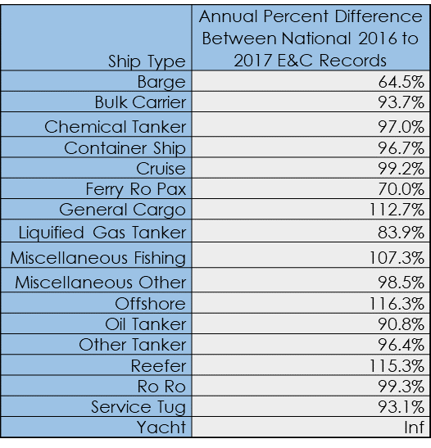
Marine Workgroup: 2016v1
Adjustments for v1
  Backcast the AIS-based CMV inventory being developed for the 2017 NEI to 2016
  Adjustments based on USACE Vessel Entrances & Clearances data, by C3 vessel type (see table)
  Use an aggregate adjustment of 98% for C3 yachts, tugs, barges, fishing vessels, and all C1/C2 vessels

Slide 50
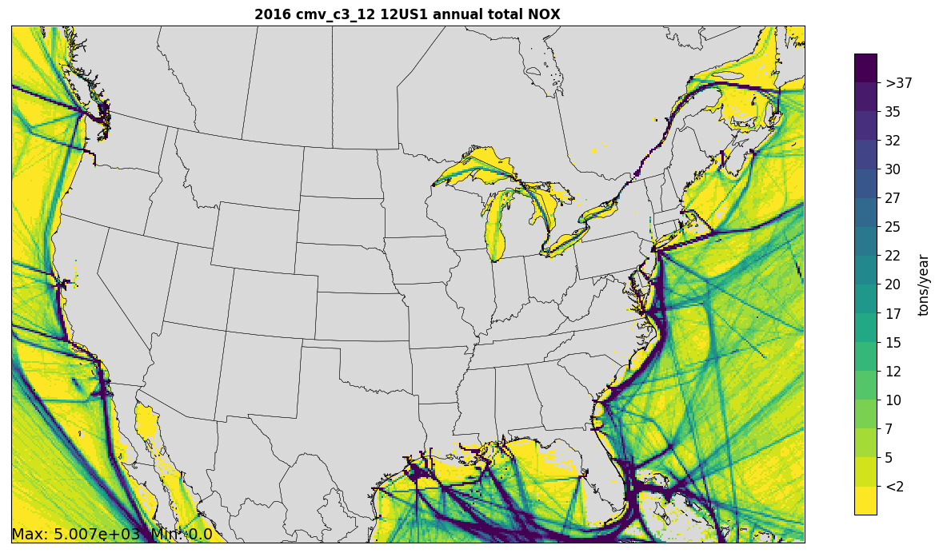
CMV C3 Annual Total NOx Emissions

Slide 51
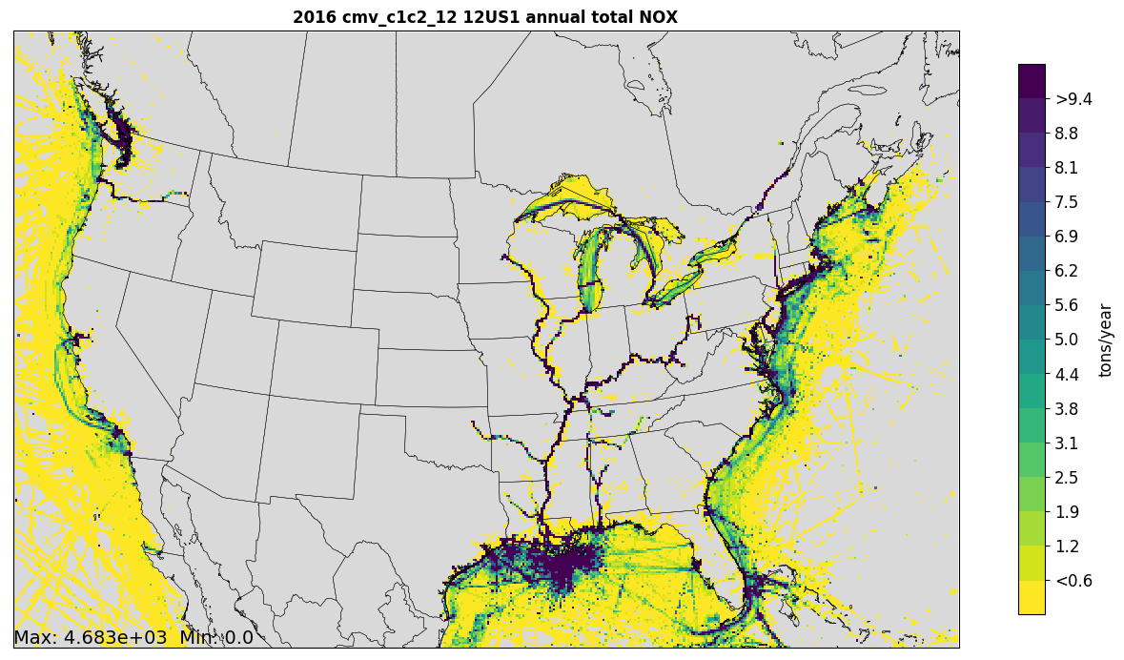
CMV C1C2 Annual Total NOx Emissions

Slide 52
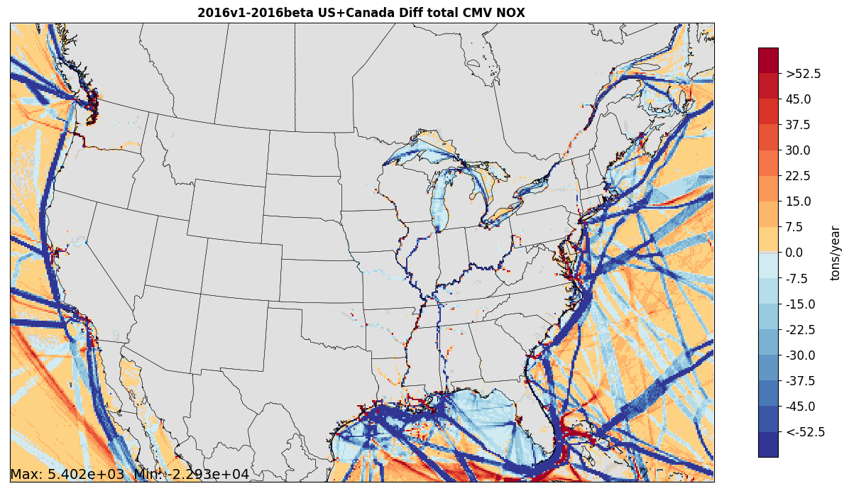
Difference between 2016v1 and 2016beta CMV Annual NOx Emissions

Slide 53
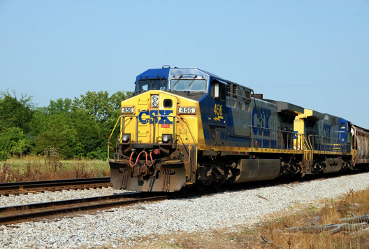
Rail Workgroup
Lead Mark Janssen (LADCO)
Schedule: As needed
Wiki: http://views.cira.colostate.edu/wiki/wiki/9182

Slide 54
Rail Workgroup: 2016v1
Approach
  Incorporated comments from states
  Updated growth rates based on new AEO projections
  Include better growth estimates of fleet technology
Differences from beta
  Fixed circular logic in inventory spreadsheets

Slide 55
Projection Methodology Overview
Started with Energy Information Administration’s Annual Energy Outlook (AEO) freight rail energy use growth rate projections for 2016 to 2050.
Added in a correction factor for 2017 to account for the abnormally low amount of Class I line-haul fuel use in 2016.
Used modified AEO growth rates to project Class I line-haul fuel use for 2020, 2023, 2028.
Used 2007, 2014, 2016, and 2017 Class I fleet mix data to create projected Emission Factor trendlines for NOx, PM10, and HC.
Determined future year Emission Factor estimates for 2020, 2023, and 2028.
Used 2016 FRA MGT data, Adjusted RFCI values, and EF estimates to create future year link, state, and county emission estimates for 2020, 2023, 2028.

Slide 56
Rail Workgroup: 2016v1

Slide 57
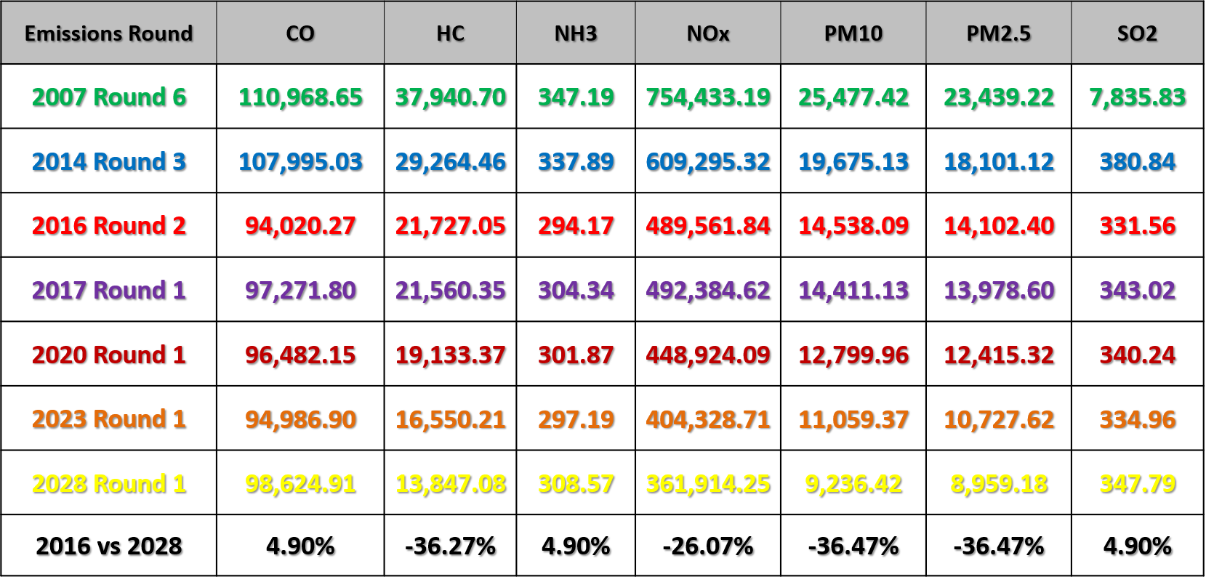
Line Haul Projection Results

Slide 58

Oil and Gas Workgroup
Co-leads: Tom Richardson(OKDEQ), Jeff Vukovich (EPA)
Schedule: Calls on 2nd Monday at 2pm Eastern
Wiki: http://views.cira.colostate.edu/wiki/wiki/9180

Slide 59
Oil and Gas Emissions Workgroup
Summary
  Updated PA and IL non-point base year inventory
  Improved future-year projections where possible
  Incorporated any state/MJO updates
Differences from beta: base year
  Pennsylvania provided unconventional well-related emissions
    EPA O&G tool used for conventional well-related emissions
    Impact: NOx up 16K tons and VOC down 56k tons
  Illinois provided updated active well information
    48K active wells in 2016beta but actual active wells about 20K
    Impact: NOx down 14k tons and VOC down 48K tons
  Virginia provided new 2016 Natural Gas transmission emissions

Slide 60
Oil and Gas Emissions Workgroup
Differences from beta: future-year projections
  Production-related sources (SCCs in nonpoint and NAICS in point sources) used AEO2019 reference case (used AEO2018 in beta)
  Used 4-year average (2014-2017) emissions dataset for non-point exploration-related sources
  Added NJ control information for pipeline compressor(s)
  Used VA natural gas transmissions future year emissions
Milestones
  Expected release date:
    WG Base year and future-year inventory : Early October
WRAP Baseline inventory has arrived!
  Summary slides follow

Slide 61
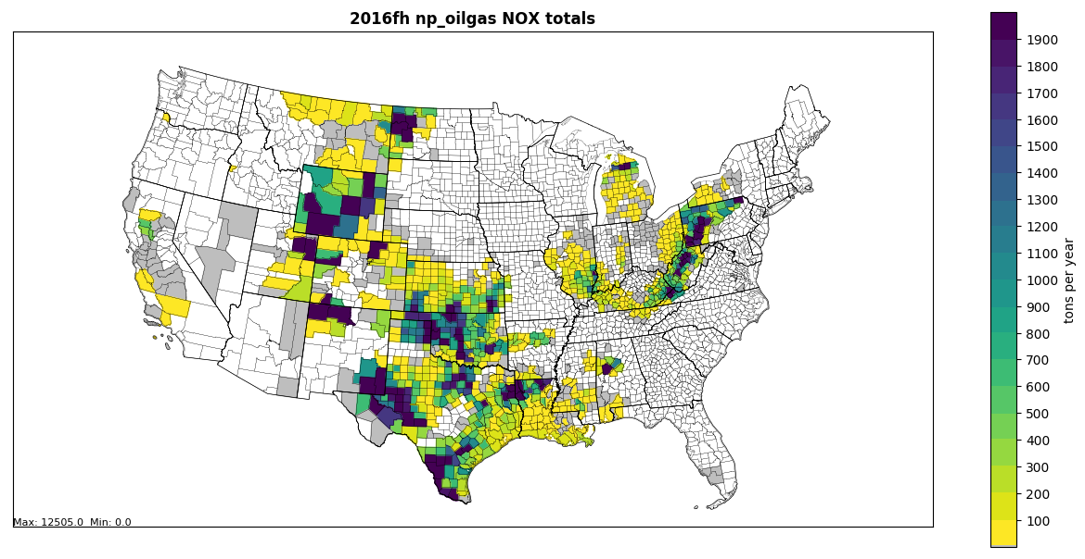
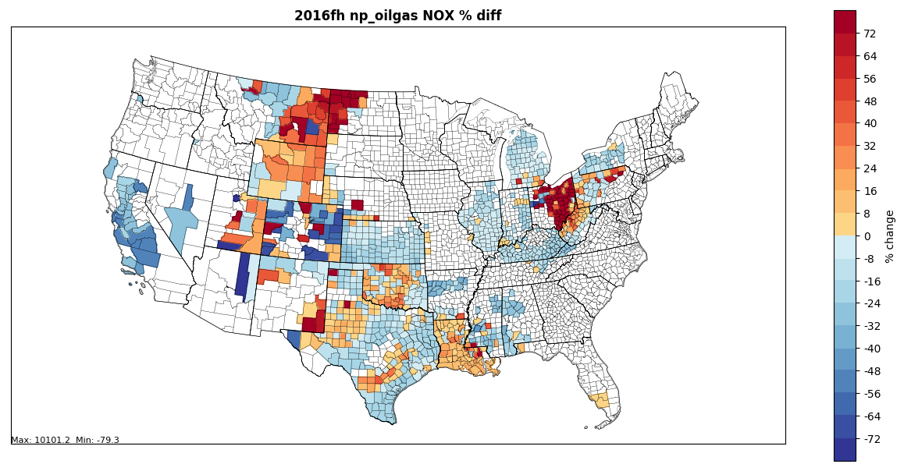
2016 version 1
Nonpoint oil and
gas NOx (tons/yr)
2028 – 2016 NOx
% change in
nonpoint oil and gas emissions

Slide 62


WRAP Oil and Gas Work Group
WRAP Oil and Gas Work Group (OGWG):
  Promote understanding of the role of oil and gas in regional and local air quality plans
  Address the data and analysis elements, topics, and issues related to air quality impacts from the oil and gas sector
  OGWG materials at: https://www.wrapair2.org/OGWG.aspx
Oil and Gas Work Group (OGWG) Formation:
  Members with applicable oil and gas expertise and geographic representation from WRAP member agencies (state, tribal, local, federal)
  Initial OGWG Call – November 15, 2016
Co-Chairs:
  Amanda Brimmer, Regional Air Quality Council (RAQC), Denver, CO
  Mark Jones, New Mexico Environment Department, Farmington, NM
  Darla Potter, Wyoming DEQ - Air Quality Division, Cheyenne, WY

Slide 63
Western 7-state Baseline O&G EI data replacement for National Emissions Collaborative v1 release
Baseline Planning Inventory Revisions
  Williston Basin Casinghead Gas Revision, Inclusion of new inventories within Colorado
Speciation Profile Updates
Revised Timeline
Baseline Year Alaska and Intermountain Region Emissions Inventory revised final deliverables – Sept. 2019 - the Revised Final Report and Inventory Spreadsheet were completed in mid-Sept. The gas profile information posted in July is unchanged.
Applies results from OGWG Emissions Survey for State Air Agencies and O&G Operators
  Complete survey (January 2019)
  Fleet turnover and controls-focused survey (January 2019)
  WRAP OGWG Survey Data Collection Synthesis Memo, Ramboll
  WESTAR-WRAP Base Case:
    2014 base case (v1) emission inventory spreadsheet
    2014 oil and gas activity spreadsheet

Slide 64
Williston Basin CASINGHEAD Gas Revision
Updated Inventory Inputs
  EIA vented and flared volumes
  BLM and WESTAR-WRAP 2011 vent/flared split (0.3% vented/99.7% flared)
  Implementation of updated associated gas composition speciation profiles (increase SO₂)
Consider testing/verifying Tool casinghead gas assumptions for other non-WRAP basins
Updated Emissions

Slide 65
Colorado Emission Inventory Updates
Integrating revised inventories into baseline
Colorado DPHE provided emissions inventory for non-tribal lands
Southwestern Colorado includes two areas with oil and gas activity on tribal lands
  Southern Ute Indian Tribe (SUIT): Provided 2017 inventory
  Ute Mountain Ute: Based on WRAP 2014 Base Year inventory
Product is SMOKE-ready 7-state point/non-point emission inventory inputs for WRAP region
  Updated Baseline EI files sent in Sept. to OAQPS for Emissions Collaborative v1 integration

Slide 66
Speciation Profile Updates & Projections Deliverables
Memo available at gas profiles
Over 300 gas composition profiles were submitted by operators and state agencies in response to the WRAP OGWG survey effort
Vast majority of gas composition profiles were received for Williston Basin oil well associated gas and tank flash gas
Ramboll compiled average gas composition profiles weighting by activity surrogate.
  Gas production activity surrogate is primary gas (for gas wells) and associated gas (for oil wells). For tank flash gas, the activity surrogate is condensate production (for gas wells) and oil production (for oil wells).
Future year 2023 Emission Inventory + Report
  Sep 20: Draft for WRAP OGWG Member Review
  Oct 1: Member Review Comments Due
  Oct 8: Final inventory, report, and SMOKE-ready emission inventory inputs

Slide 67
Biogenic Emissions Workgroup
Summary
  Used Environment Canada’s Biogenic Emissions Landcover Database version 4 (BELD4) 1km resolution dataset to update landuse for their country
    Only able to update landuse for Biogenic Emissions Inventory System version (BEIS3)
  No changes for Model of Emissions of Gases and Aerosols from Nature (MEGAN3) version 3 for 2016v1
Differences from beta
  For Canada, the 17 MODIS landuse types were replaced by 92 different BELD4 landuse types from Environment Canada
  Canadian landuse changes resulted in significant changes in VOC emissions and some impact on biogenic NOx emissions

Slide 68
Biogenic Emissions Workgroup
Milestones
  Expected release date: Early October
Other related activities
  Have begun evaluation of both biogenic emissions models for summer 2013 using observed emissions flux data available for this time period
  MEGANv3.1 release may occur later this year
  EPA ORD working on a new version of BELD

Slide 69
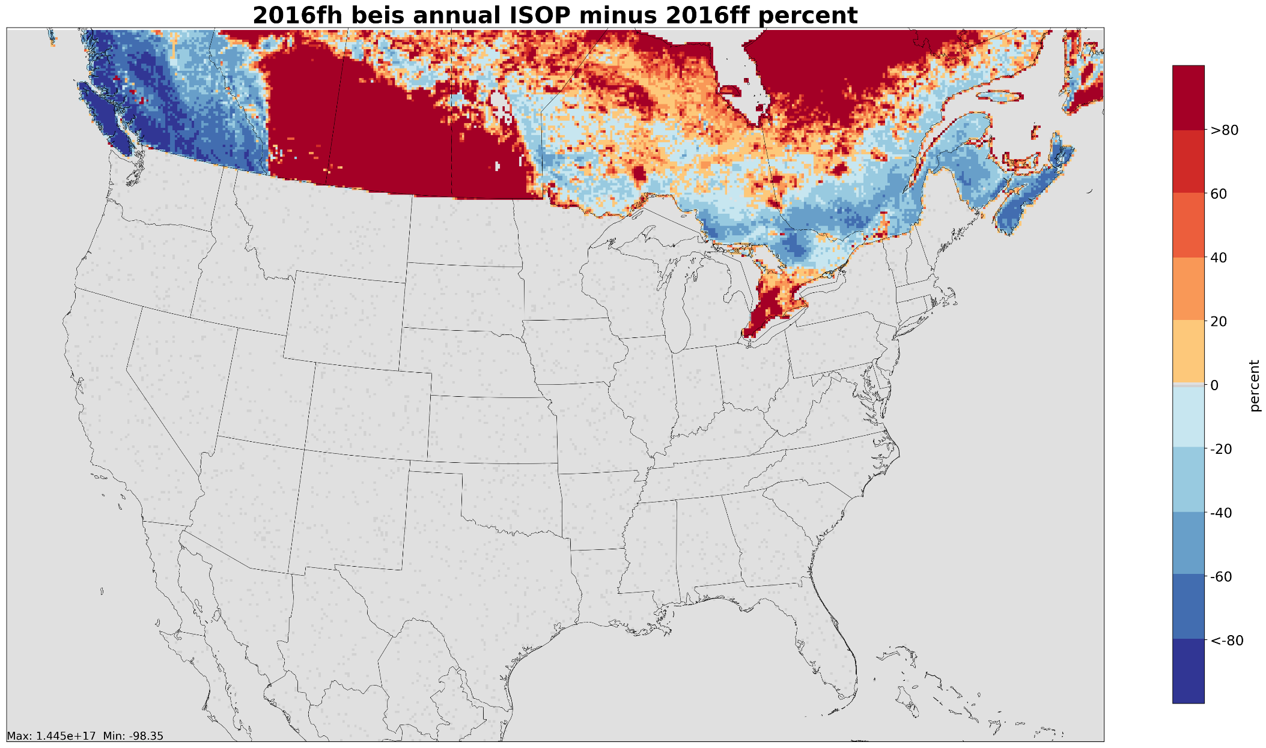

Slide 70
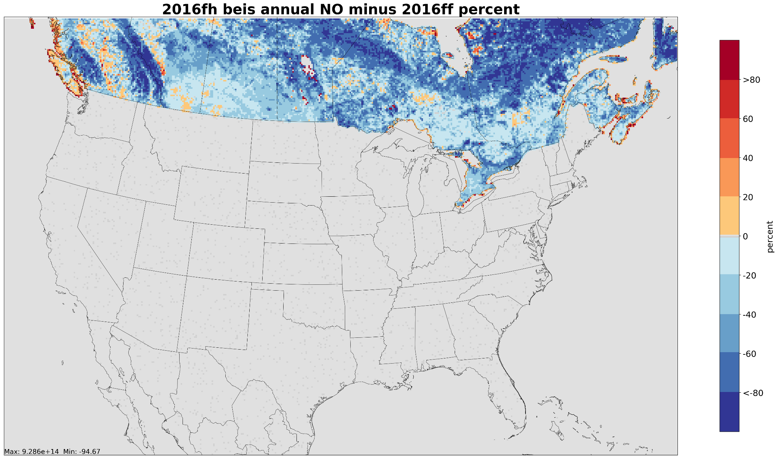

Slide 71
Fires Workgroup
(Agricultural, prescribed and wildland fires)
Lead: Jeff Vukovich (EPA)
Schedule: May now meet quarterly; TBD
Wiki: http://views.cira.colostate.edu/wiki/wiki/9175

Slide 72
Fires Emissions Workgroup
Summary
  Implement newly acquired Fire information databases
    US Forest Service FACTS: prescribed burns [shapefiles]
    US Fish and Wildland Service (USFWS): wildfire and Rx
    New Jersey: wildfire and prescribed
    Georgia: day-specific ag burns (beta used month-specific)
  Cleaned up obvious duplicate and bad fire information
Differences from beta
Overall wildfire and prescribed burn acres burned up from 17M acres (beta) to 17.1M acres
Prescribed acres burned up from 11.4M (beta) to 11.9M
Wildfire acres burned down from 5.61M (beta) to 5.2M
Deleted bad or duplicate fire information for major wildfires
Largest changes in acres burned are in CA, CO, SD, and OR

Slide 73
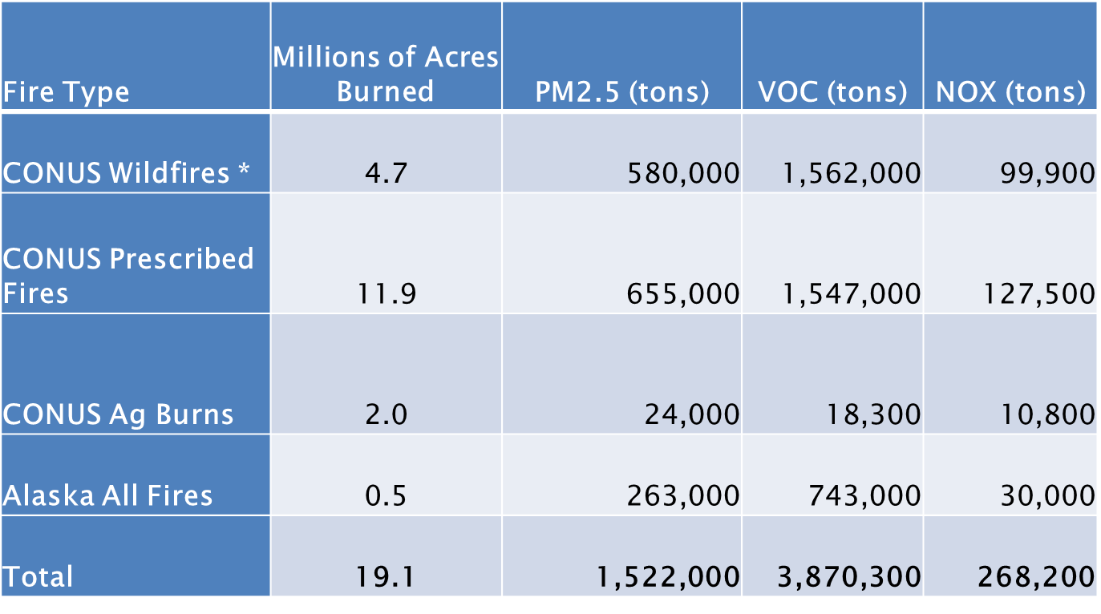
Fires Emissions Workgroup
Milestones
  Expected release date: Early October

Slide 74
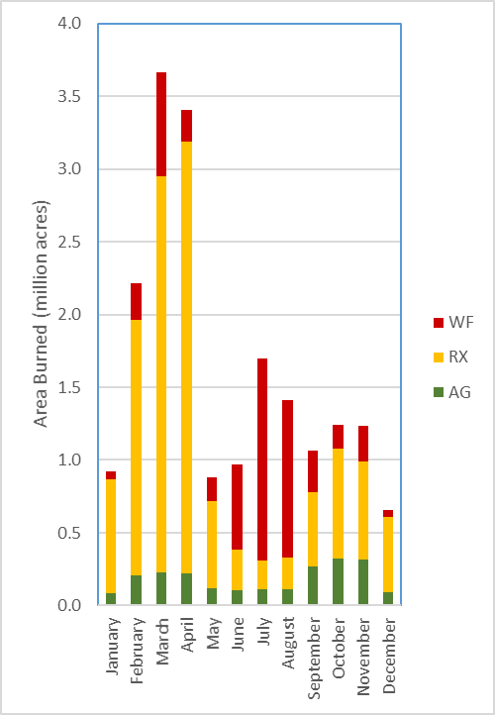
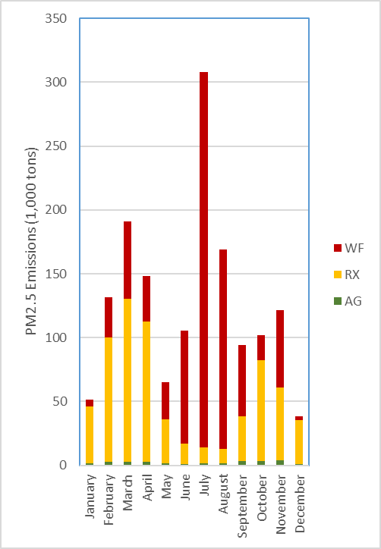
Results: U.S. Type Monthly
Notes:
July has a huge amount of PM because it has a lot of wildfires and they are in forests. March has more total acres, but they are prescribed grass burns.

Slide 75
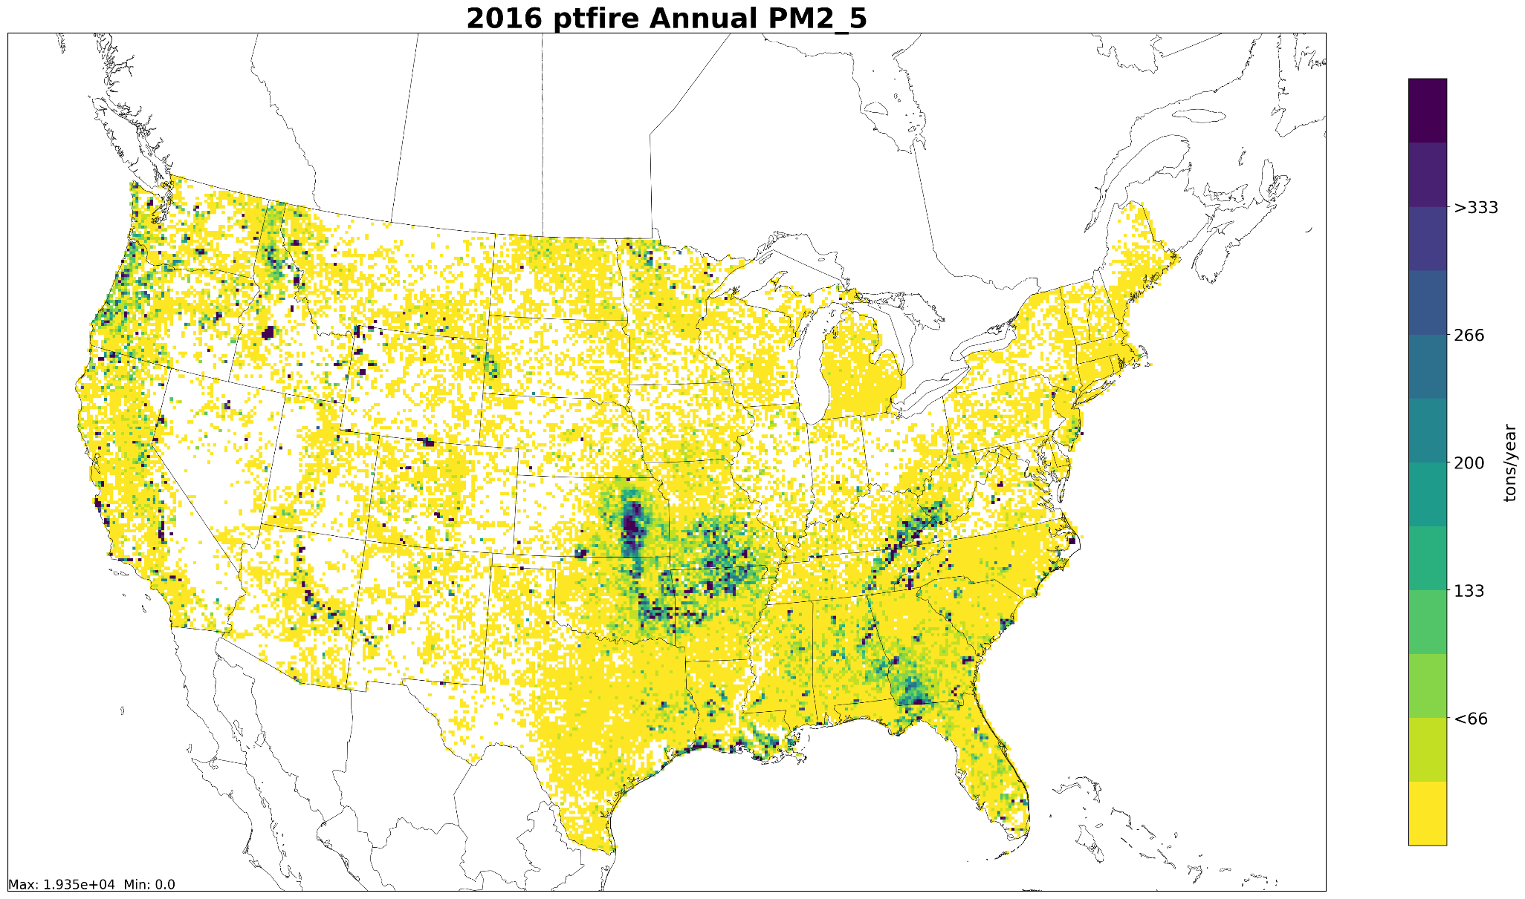
Gridded Annual PM2.5: 12km resolution
Includes wildfires and prescribed burns

Slide 76
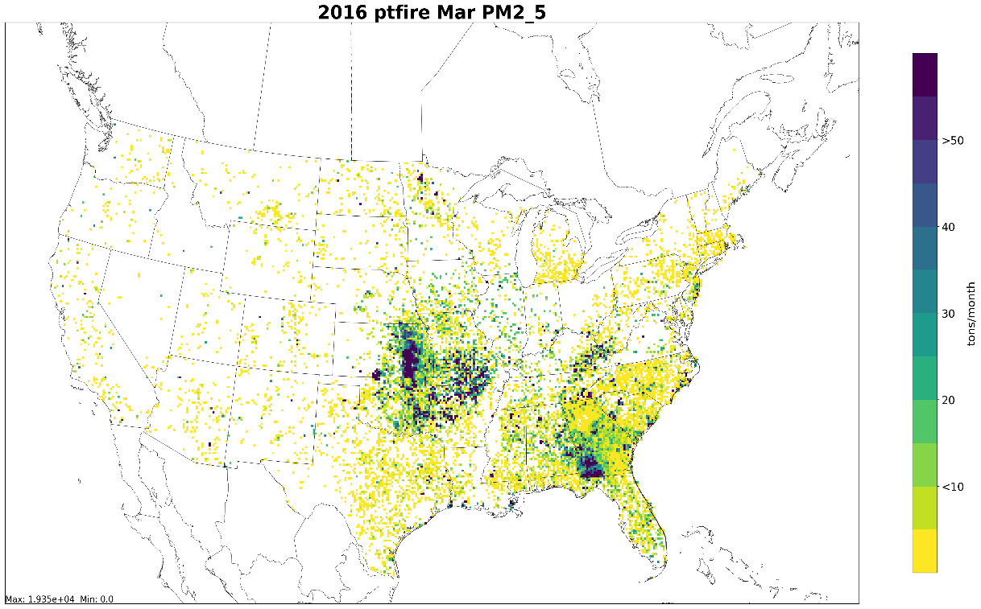
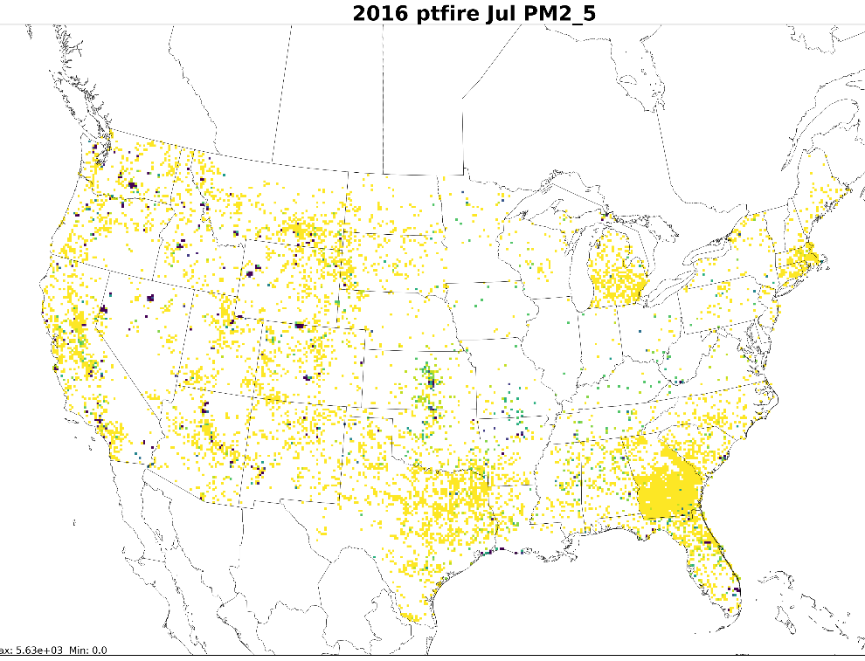
Gridded Monthly PM2.5: 12km resolution
March
July
60
Includes wildfires and prescribed burns

Slide 77
International Emissions
Environment and Climate Change Canada provided year 2015 data and factors to adjust to future years
  Suspiciously high PM was noticed in Alberta / Saskatchewan and Canadians agreed
  Adjustments to PM in these areas were developed for regional haze and 2016v1 modeling
Mexico
  EPA made a concerted effort to reach out to SEMARNAT about their 2016 inventory
  SEMARNAT has not yet provided the 2016 inventory
  CARB noted that summary information for their 2016 inventory is posted on the SEMARNAT website
    It’s possible that adjustments can be computed from this to create an interim modeling inventory (but not by October)

Slide 78
Emissions Modeling Workgroup
Co-leads: Eric Zalewsky (NYSDEC), Zac Adelman (LADCO)
Schedule: Calls on 4th Thursday at 3:00pm Eastern
Wiki: http://views.cira.colostate.edu/wiki/wiki/9190

Slide 79
Emissions Modeling Workgroup
Approach: To test and help document the emissions modeling platform
Work on 2016v1
  LADCO downloaded v1 pre-release platform scripts and data and are processing through SMOKE
  Creating plots and charts for comparison to past platforms
  Planning for v1 documentation review
  NYSDEC, LADCO & VADEQ developing scripts and documentation to incorporate ERTAC EGU option in V1Platform

Slide 80
Emissions Modeling Workgroup
Plans for the next quarter
  Detailed analysis of the 2016v1 emissions: comparison to past EMPs (2011, 2014, 2016beta), evaluate ancillary data
  Process new modeling domains and conduct air quality modeling/analysis
  Process future year inventories (2023 & 2028)

Slide 81
Emissions Modeling Workgroup
Approach for v1: The same as for beta
  Review/edit documentation
  Test platform scripts
  Plot emissions results
  Compare v1 to beta and previous national modeling platforms

Slide 82
EPA-State 2016 Model Evaluation Forum
Goal of Forum
  To promote collaboration with state partners on characterizing and understanding model performance and identifying performance issues for possible further research by EPA and/or the modeling community and to serve as a venue for sharing data and evaluation results
Membership: 92 members:
  Environment Canada, EPA, BLM, NPS, 25 states, 4 local air agencies, MJOs
Workgroup meetings are ongoing now
Model inputs and outputs for beta platfrom are on the IWDW
Plots are on LADCO’s web site
  https://www.ladco.org/technical/modeling-results/epa-2016-modeling
SharePoint site allows forum members to access information about the forum, the model simulations, past and upcoming meetings, available data, discussion board, and wiki page
The forum is expected to continue as 2016v1 modeling results become available

Slide 83
Inventory Collaborative Next Steps
Data will begin to be released the first week of October (see http://views.cira.colostate.edu/wiki/wiki/9169#2016v1-Platform )
Draft and final documentation will be posted
SMOKE will be run for future years
Plots and summaries will be generated and posted
Air quality modeling with 2016v1 will begin
Workgroups to determine future steps – merge with other work groups, continue as before, meet at reduced frequency, etc.
We would appreciate information on prospective uses of the v1 platform
Outreach calls by the Collaborative will report out on uses and provide updates: mark your calendar
Next outreach call:
Thursday, January 23, 2020 at 12:00 Eastern

Slide 84
Inventory Collaborative Wiki Links
These slides, answers to the questions posed during this webinar, notes:
  http://views.cira.colostate.edu/wiki/wiki/11202
Main National Inventory Collaborative Wiki includes workgroup wikis, documentation, etc:
http://views.cira.colostate.edu/wiki/wiki/9169
LADCO Plot Viewer
https://www.ladco.org/technical/modeling-results/2016-inventory-collaborative/
IWDW Interactive Plotting Tool
http://vibe.cira.colostate.edu/iwdwx/Emissions/2016EMP

